Slide 1
ASP.NET

Slide 2
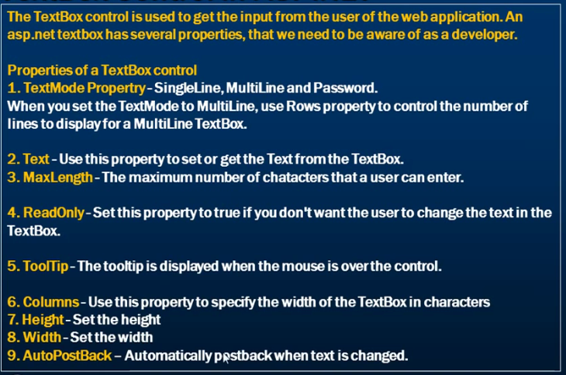
TextBox control

Slide 3
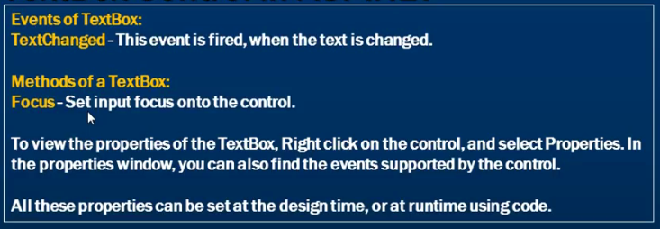
TextBox Control

Slide 4
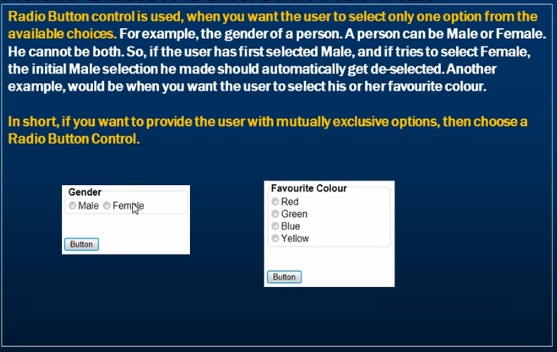
RadioButton

Slide 5
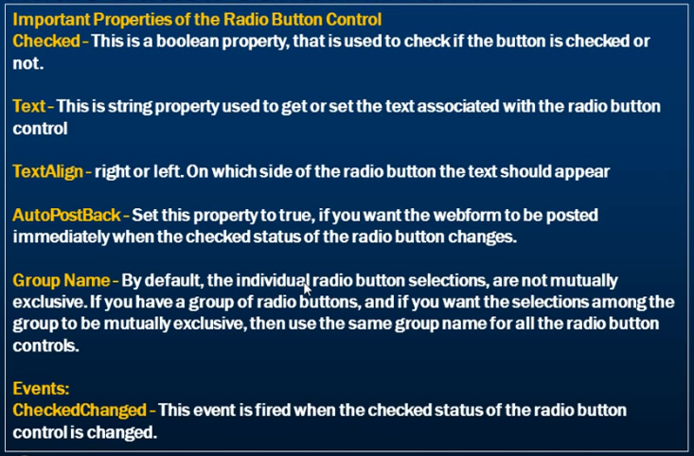
RadioButton

Slide 6
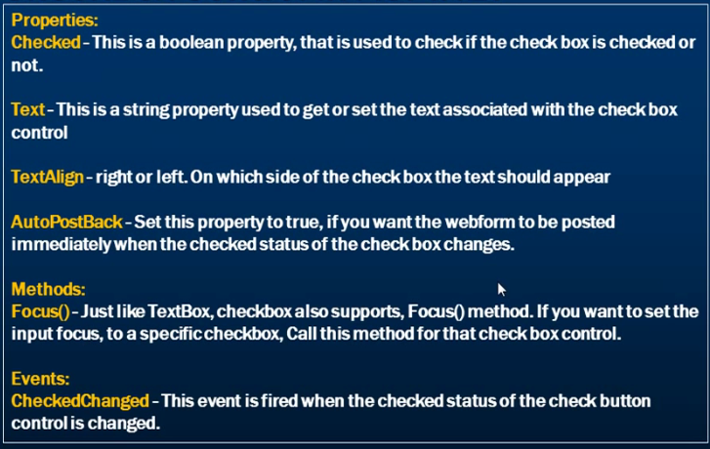
CheckBox

Slide 7
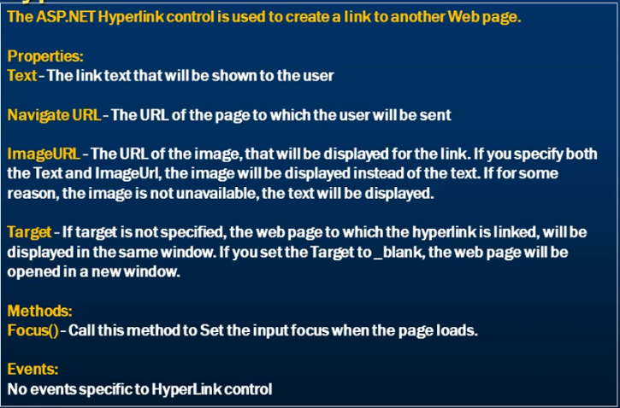
HyperLink Control

Slide 8
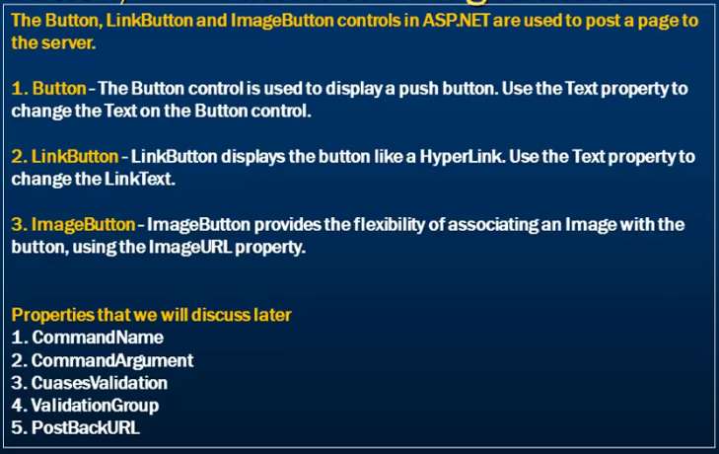
Button, LinkLinkButton, ImageButton

